Slide 1
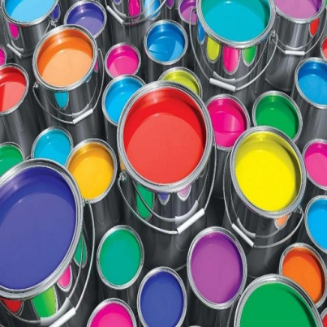

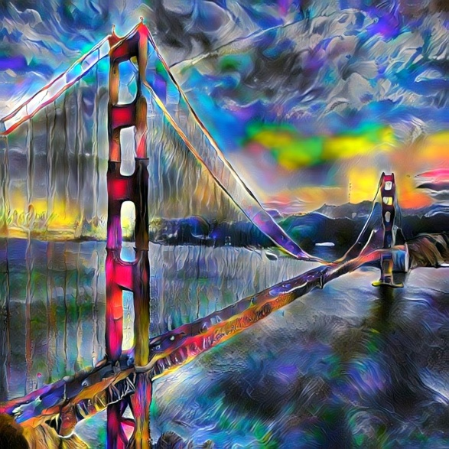
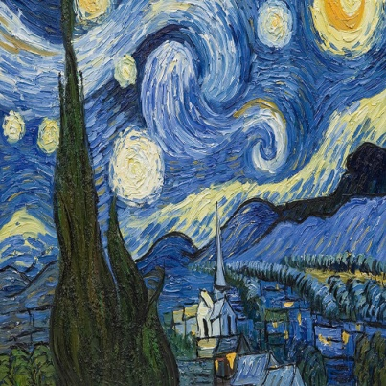

Universal Style Transfer via Feature Transform
+
=
Eyal Waserman
Carmi Shimon
Li et al. NIPS 2017
Notes:
- Carmi: Talk about background for Style Transfer, look at related work and add

Slide 2
Universal Style Transfer via Feature Transform
PyTorch Tool for Style Transfer available at https://github.com/eyalw711/universal_style_transfer
Innovative technique to enhance style transfer effect
Innovative new techniques to merge styles more efficiently
Eyal Waserman
Carmi Shimon
Notes:
Carmi

Slide 3
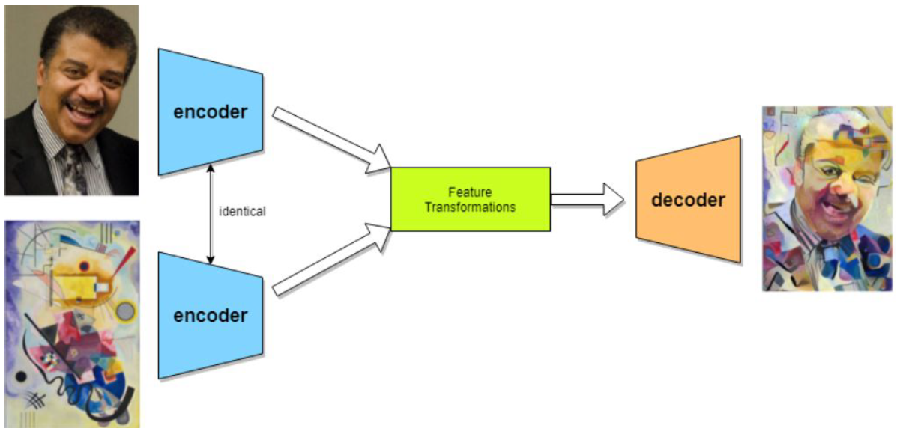
Stylization based on Feature Transform
Image source: https://ai.googleblog.com/2016/02/exploring-intersection-of-art-and.html
Notes:
Carmi
Our implementation for UST is based on encoder-decoder neural network.
Explain what is content, what is style, talk about decoder, encoder and the need of them. What is Feature Transform

Slide 4
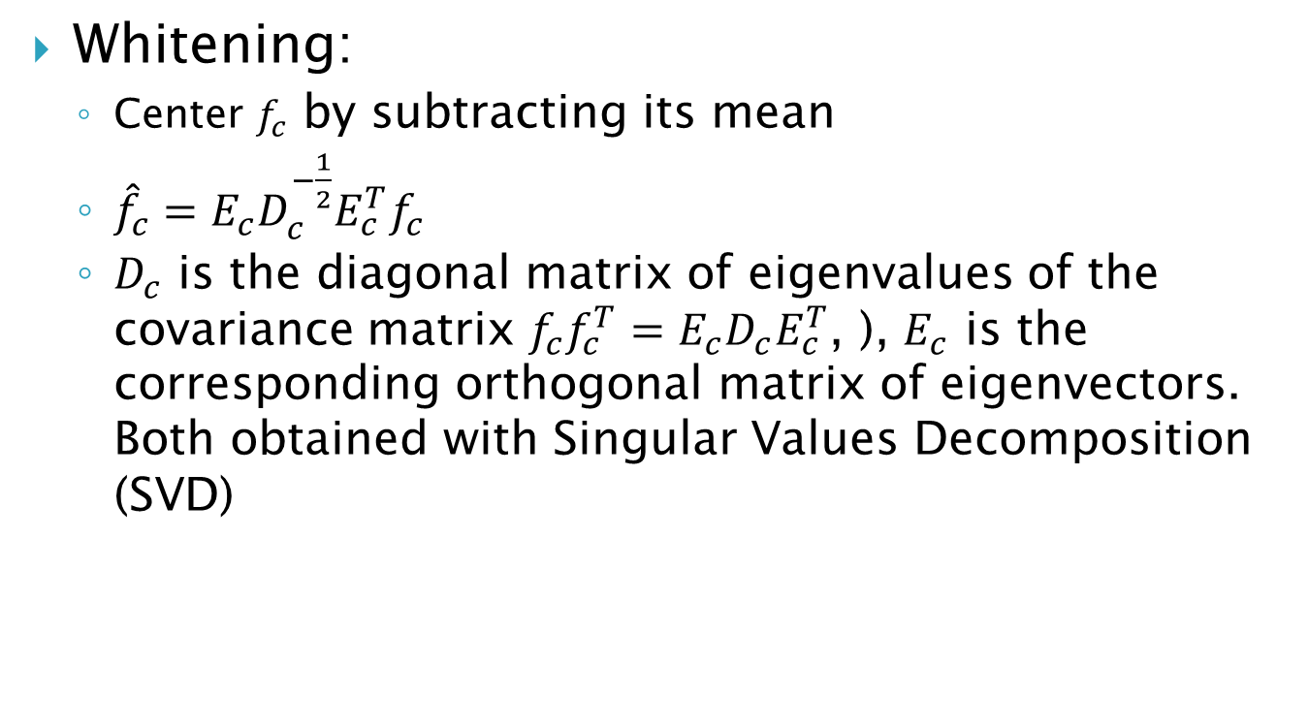
WCT
Whitening:
Center $f_{c}$ by subtracting its mean
${\hat{f}}_{c}=E_{c}D_{c}^{−\frac{1}{2}}E_{c}^{T}f_{c}$
$D_{c}$ is the diagonal matrix of eigenvalues of the covariance matrix $f_{c}f_{c}^{T}=E_{c}D_{c}E_{c}^{T}$, ), $E_{c}$ is the corresponding orthogonal matrix of eigenvectors. Both obtained with Singular Values Decomposition (SVD)
Notes:
Carmi
How do we use Feature Transform such as WCT for ST. Whitening, Coloring

Slide 5
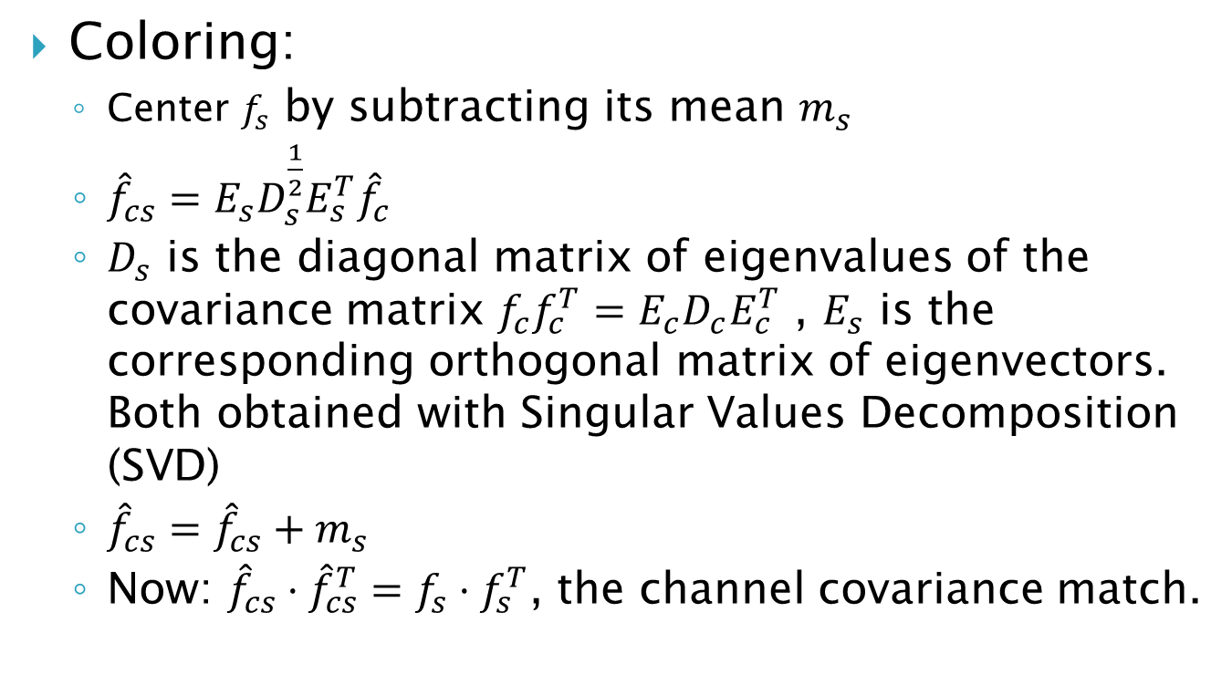
WCT
Coloring:
Center $f_{s}$ by subtracting its mean $m_{s}$
${\hat{f}}_{cs}=E_{s}D_{s}^{\frac{1}{2}}E_{s}^{T}{\hat{f}}_{c}$
$D_{s}$ is the diagonal matrix of eigenvalues of the covariance matrix $f_{c}f_{c}^{T}=E_{c}D_{c}E_{c}^{T}$ , $E_{s}$ is the corresponding orthogonal matrix of eigenvectors. Both obtained with Singular Values Decomposition (SVD)
${\hat{f}}_{cs}={\hat{f}}_{cs}+m_{s}$
Now: ${\hat{f}}_{cs}⋅{\hat{f}}_{cs}^{T}=f_{s}⋅f_{s}^{T}$, the channel covariance match.
Notes:
Carmi
How do we use Feature Transform such as WCT for ST. Whitening, Coloring

Slide 6
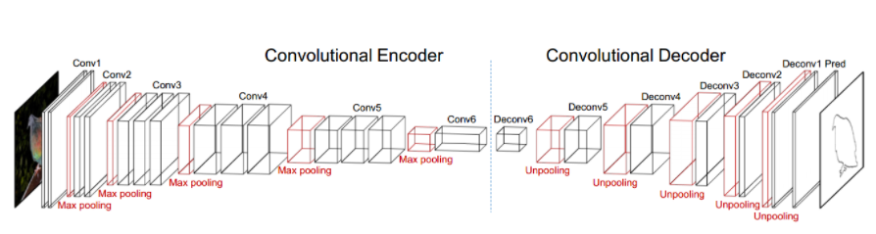

Feature Transform Using VGG-19 Encoder-Decoder
Image source: Li et al.
Notes:
Eyal
Single level stylization pass

Slide 7
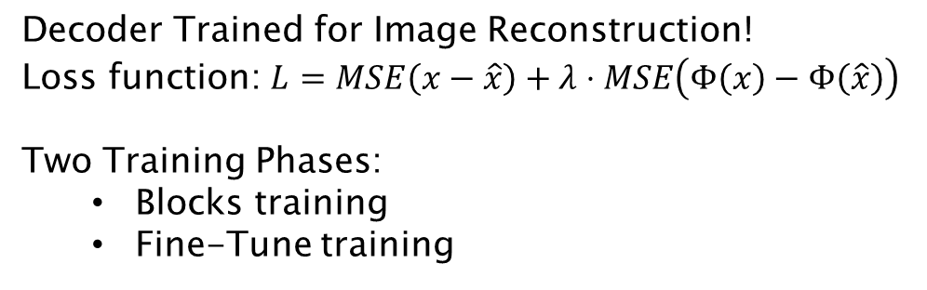
Model Training
Decoder Trained for Image Reconstruction!
Loss function: $L=MSE\left(x−\hat{x}\right)+λ⋅MSE\left(Φ\left(x\right)−Φ\left(\hat{x}\right)\right)$
Two Training Phases:
Blocks training
Fine-Tune training
Image source: Li et al.
Notes:
Eyal
Talk about training: COCO dataset
Encoder – no training
Decoder – loss function (comparison to original loss func with L2-loss)
Easier to train shallower architectures, and get better reconstruction. Deep architectures are large models difficult to train

Slide 8
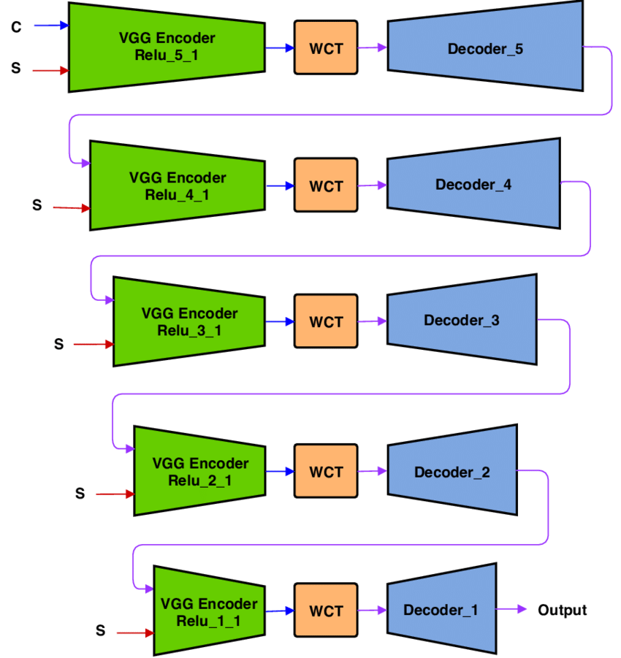
Algorithm Architecture
Image source: https://www.researchgate.net/figure/Universal-Style-Transfer-architecture-with-the-whole-multi-level-pipeline-Each-level-of_fig3_327495907
Notes:
Eyal
Multi-level stylization pipeline
Main reason for this pipeline is to match channel covariance of features in different CNN depth
VGG-19 architecture does 5 max-pooling layers – so we can use it to obtain 5 meaningful feature extractors (סיבה למה לא יותר)
On the other hand, this depth helps stylizing, so shallower pipelines give worse results.

Slide 9
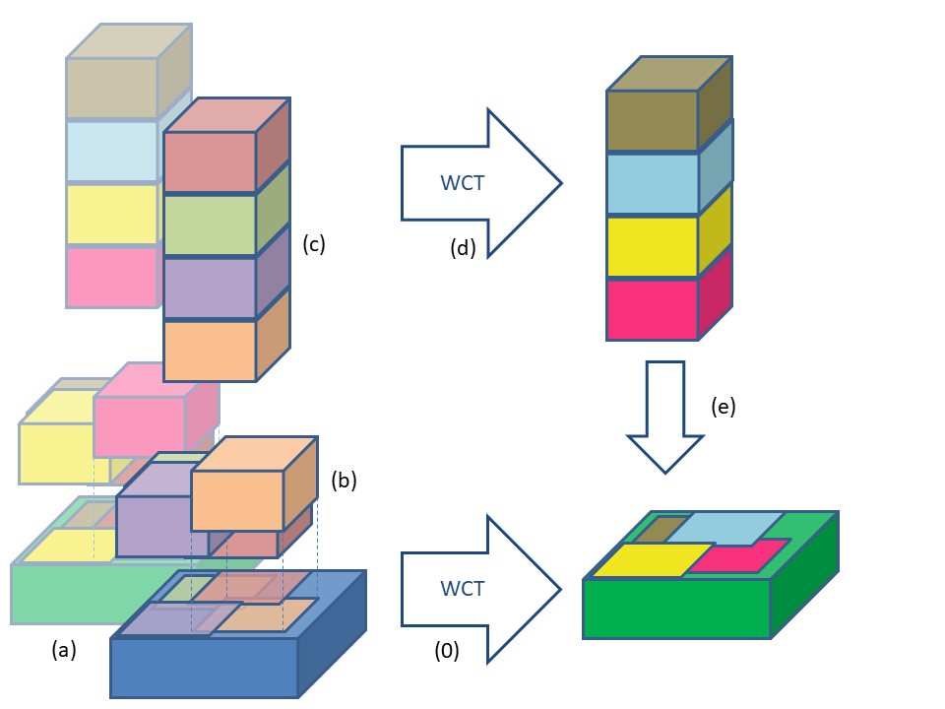
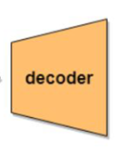
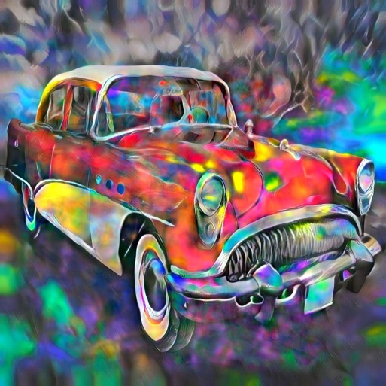
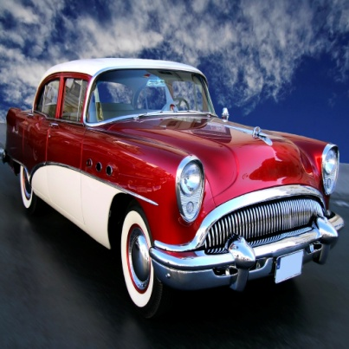
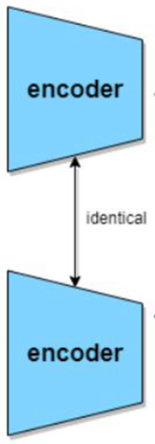
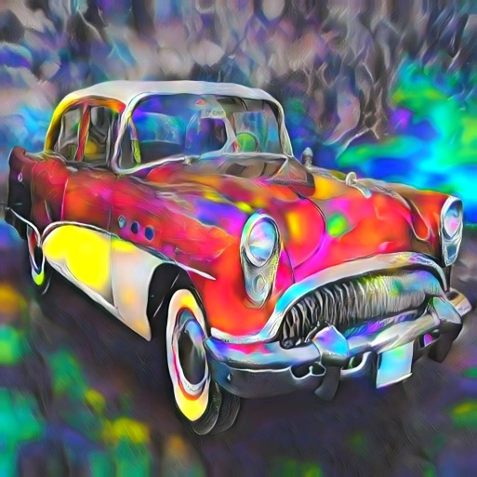

Stylization Boosting
Boost
No Boost
Notes:
Eyal
טכניקה חדשנית שלנו להגברת האפקט של העברת הסטייל
מתבססת על הגדלה מלאכותית של מספר הערוצים בפיצ'רים שמוציא האנקודר
Pros:
adds only one WCT per pipeline level so still very efficient
adds more details and colors without harming the content
Can control boosting regions

Slide 10
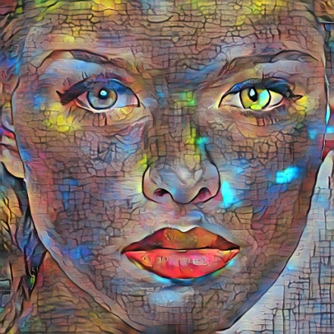
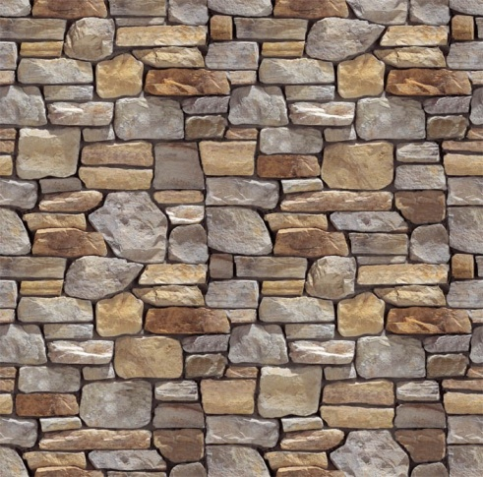
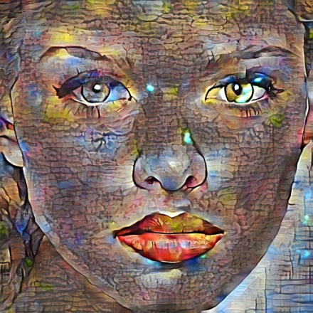
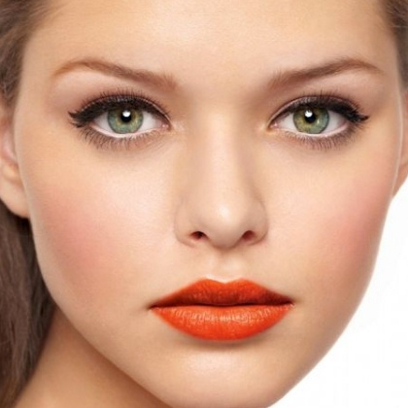
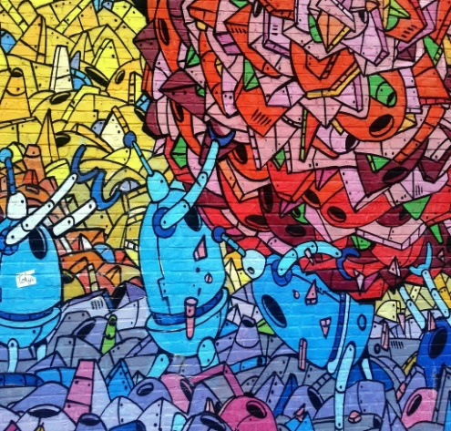
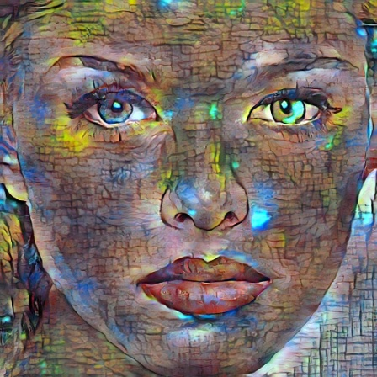
Two Style Merging
Interp. Merge
Level Merge
Channel Merge
Notes:
Carmi
להציג את האפשרות להעביר סטייל משתי תמונות סטייל
במסגרת הפרוייקט בחנו שיטות נוספות לבצע את הפעולה בצורה יעילה יותר חישובית מהשיטה הקיימת

Slide 11

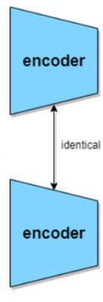








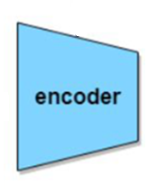







Original Merge
$$f_{s_{1}}$$
Style1
$$f_{cs_{1}}$$
$$f_{c}$$
$$β⋅f_{cs_{1}}+\left(1−β\right)f_{cs_{2}}$$
Content
$$f_{cs_{2}}$$
$$f_{s_{2}}$$
Style2
Deep feature channels
Notes:
Carmi
What we see here is just a single level in the pipeline
Important – original method does two WCT calls – heavy (2 WCT = 4 SVD)

Slide 12
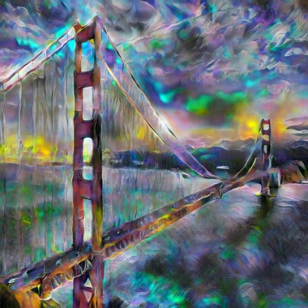
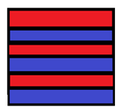





Channel Merge
$$f_{s_{1}}$$
$$f_{s_{1,2}}$$
Style1
$$f_{s_{2}}$$
$$f_{cs}$$
Style2
$$f_{c}$$
Content
Deep feature channels
Notes:
Eyal
One WCT = 2 SVD

Slide 13
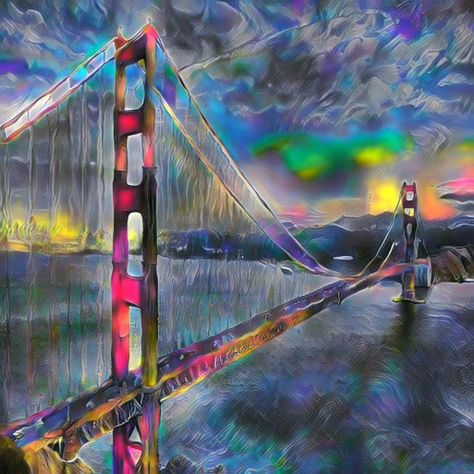





Interpolation Merge
$$f_{s_{1}}$$
$$f_{s_{2}}$$
$$β⋅f_{s_{1}}+\left(1−β\right)f_{s_{2}}$$
$$f_{cs}$$
$$f_{c}$$
Deep feature channels
Notes:
Eyal
One wct = 2 svd
Interpolate before WCT instead of after in original method

Slide 14
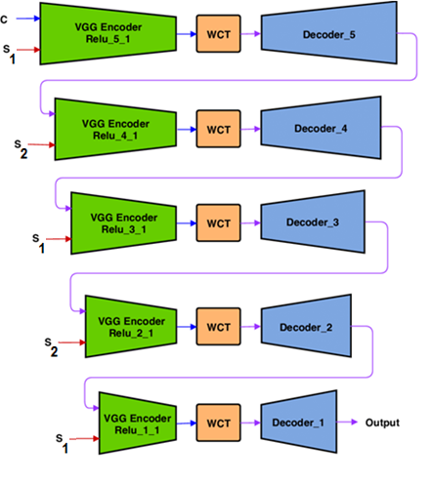
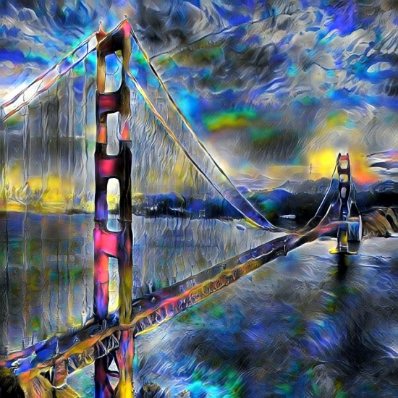
Level Merge
Notes:
Eyal
One WCT per level – this is the fastest

Slide 15
Questions?
Clone Tool from: https://github.com/eyalw711/universal_style_transfer
Eyal Waserman
Carmi Shimon

